Slide 1

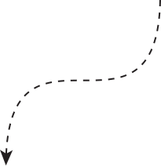



By Miguel, Stijn, Michael and Frank
Data Science
DISNEY WORLD
ASSIGNMENT

Slide 2





Agenda
Introduction
Working with github
ML predictions
Planning algorithm
Flask user input and Trip Recommendation

Slide 3

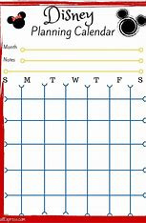
Introduction

Slide 4
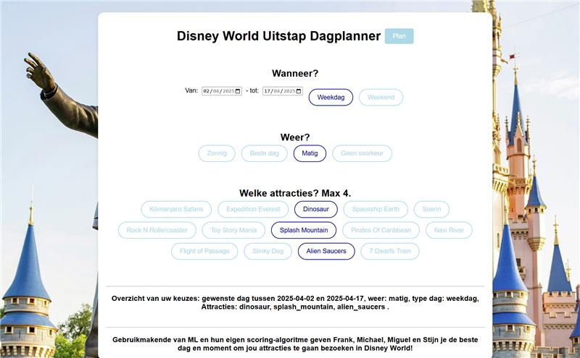
User input
User selects dates, preferences, and attractions
Flask

Slide 5
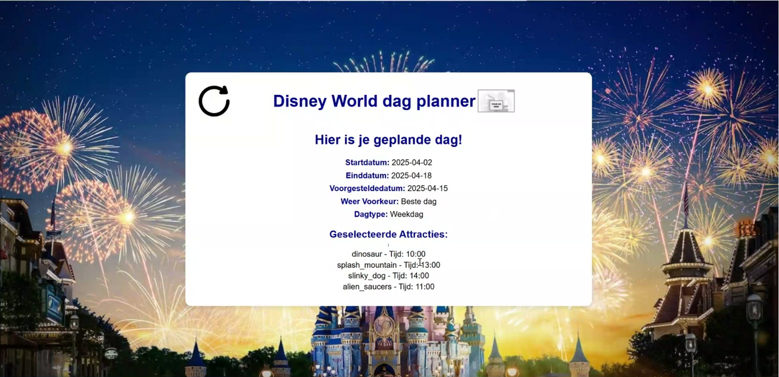
End goal
An interactive Flask application that helps users plan optimal days at Disney World.
Integration of weather forecasting, crowd prediction, and attraction preferences.
Clear visual tools (e.g., Flask) for an enhanced experience.
Trip Recommendation

Slide 6

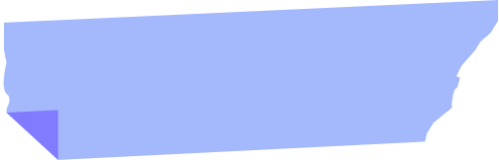

SUGGEST THE BEST DAY TO GO TO DISNEY WORLD USING A FLASK WEBBASED APP
USER INPUT VIA FLASK
XG BOOST
TRIP RECOMMENDATION
Create a Flask app (web-interface) to get the user preferences input
Use Machine Learning technique “Multi output XGBoost with scikit learn”, using weather forecasts, attraction wait times, and user preferences.
Recommend optimal visiting times by weather and attraction metrics, displayed via Flask templates.

Slide 7





Data clean up
Feature Engineering
Machine Learning
Planning algorithm
Frontend and Output
Weather features (temperature, precipitation, ..)
Date features (hour_of_day, day_of_week, ..)
Front end
Weather Data
Clean Weather Data
api.open-meteo.com
Flask routes (/home, /planning)
Attraction features (Rides, ... )
User inputs: Dates, weather preferences, attractions.
Predict (XGBoost)
Planning algorithm (weighing inmportance of weather conditions and waiting lines).
Attraction Data
Clean Attraction Data
Metadata
data/waiting times
data/overview data
Output
Trip recommended plan.
Train (XGBoost)
Suggested dates, attractions, and times
Merge Cleaned DataFrames
Feature Engineering

Slide 8
Working with github

Slide 9
Data Integration and Machine Learning Predictions

Slide 10
Flask user input and trip recommendation

Slide 11

THANK
YOU!

